Slide 1
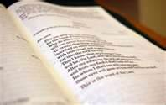
Part III of the Training:
Introduction of the
Lectionary.
Feedback and Support as a
learning and growing tool.
Actual practice of Readings
and its suggested questions.

Slide 2
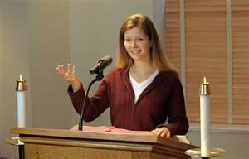
Introduction of the Lectionary
Proclaimer, the instrument that makes the message arrive
Proclaim:
pro = in front of
claim = declare on faith
The Lector PROCLAIMS!

Slide 4
The Second Vatican Council assigned three different liturgical years A, B, and C.
Matthew for year A
Mark for year B
And Luke for year C.
The Gospel of John in Easter all three years.

Slide 5
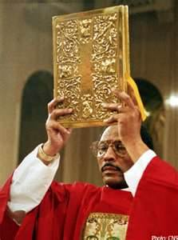
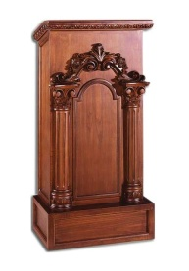
Familiarize Yourself with the Lectionary
The book that is carried in
the Entrance Procession
of Mass is the BOOK OF
GOSPEL, not the Lectionary.
The Lectionary is ready on the ambo
Neither should be taken out in
procession at the end of the Mass.

Slide 6
At the beginning has several tables.
It also contains the Index.
Has an introduction called:
“THE GENERAL INTRODUCTION
TO THE LECTIONARY” was published in 1981.
The Introduction consist in three parts:
* The Preamble (Chapter I)
* The First Part (Chapters II and III) and
* The Second Part ( Chapters IV, V, and VI)
We recommend that you familiarize yourself with Chapter IV : “General Arrangement of the Readings for Mass”.

Slide 7
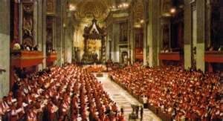
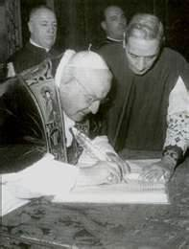
Before we only had two readings. The Second Vatican included one more.
Look at the connection in the three Readings:
The First Reading: Theme with the Liturgical Season.
The Responsorial Psalm: Theme with the First Reading
Second Reading: Feast celebrating.

Slide 8
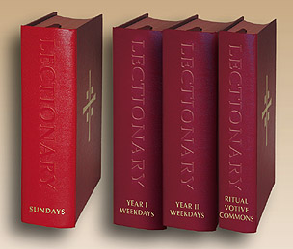
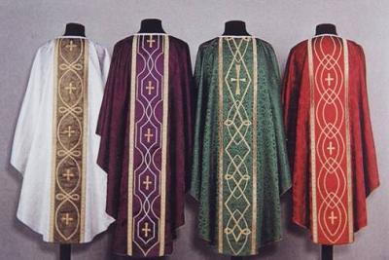
Lectionary Volumes
In Spanish we have three.
In English we have Four Volumes.
Volume I: Contains the Readings for Sundays
Volumes II and III: Contain Readings for Weekdays
Volume IV: Contains Readings for Special occasions.
Is good to learn the Seasons of
the Liturgical Year’s colors.

Slide 9
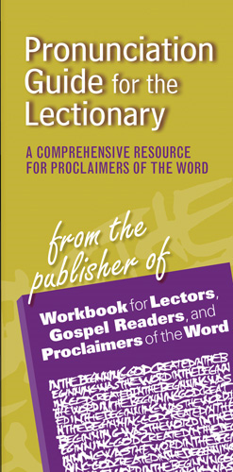
In a certain way is an abbreviated Bible.

Slide 10
Feedback and Support
Feedback
Support

Slide 11
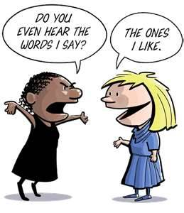
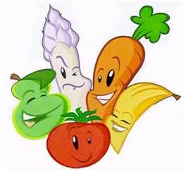
Suggested Tips for Feedback
Don’t ask and then argue with response.
Say “thank you” and work
on modifications.
Participate on a group
feedback practices.
Without input from others it’s
hard to know how well God’s Word is truly being received by the assembly.
Distinguish between effectiveness of proclamation and one’s personal taste. (Wallace, 2004, p.67; Meagher & Turner, 2007, p. 53-54)

Slide 12
Suggested Questions
Was the lector voice loud enough?
Did the phrasing of the Reading make sense?
Were words pronounced correctly? (mumbled?)
Did the pace allow people to listen and follow?
Was the nonverbal communication helpful or distracting? ( attire, posture, movement)
Did the lector look at the assembly? (eye contact)
Did the quality of voice match the mood of the Reading? (Meagher & Turner, 2007, p. 53-54)

Slide 13
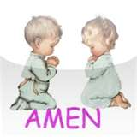
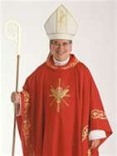
Thank You, and
May God Bless us!

